Slide 1
Hope and Help for Families Affected by Substance Use Disorders
Dennis C. Daley, PhD
Sr. Clinical Director, Substance Use Services
UPMC Health Plan
Professor of Psychiatry
University of Pittsburgh School of Medicine
daleydc@upmc.edu
March 28, 2018
Notes:
Speaker: Dennis

Slide 2
Learning Objectives
Review trends in substance use and substance use disorders (SUDs)
Identify impact of SUDs on family systems and individual members
Review challenges of patients, families and providers vis-à-vis helping families
Review interventions to help families
NOTE: this webinar was adapted from my NIDA webinar & other presentations (thanks to John Hamilton)
Notes:
Speaker: Dennis

Slide 3
Objective #1
Trends in Substance Use and Substance Use Disorders
Notes:
Speaker: John

Slide 4
Number of Past Month Illicit Drug Users among People Aged 12 or Older: 2016
No illicit drug use: 89.4%
Illicit drug use: 10.6%
Marijuana 24.0% (up from 2015)
Pain pills 3.3% (down)
Cocaine/meth 2.6% (up)
Stimulant meds 1.7% (same)
Heroin 0.5% (up)
Sedatives 0.5% (up)
Ages 18-25 25% used illicit drugs!
SAMHSA: Results from 2016 National Survey on Drug Use and Health

Slide 5
Current, Binge, and Heavy Alcohol Use among People Aged 12 or Older: 2016
Current alcohol users 136.7 million
Binge drinkers 65.3 million
Heavy drinkers 16.3 million
Ages 12-20
20% drink, over ½ binge drink, about 15% drink heavy

Slide 6
Substance Use Disorder (SUD) in the past Year, Ages 12+ (2016)
Any SUD in past year (7.5%) = 20.1 million
Alcohol use disorder 15.1
All illicit drug use disorders 7.4
Marijuana use disorder 4.0
Pain reliever DU disorder 1.8
Cocaine/meth use disorder 1.6
Heroin use disorder 0.6
Prescription stimulant disorder 0.5
Received treatment in SUD program = 10.6%

Slide 7
Substance Use Disorders Are Associated with Many Problems
Medical, dental, sexual
Disability, accidents, diseases, overdoses, decreased lifespan
Social, interpersonal, legal
Family unit and members increased risk of problems
Infants NAS & FASD
Higher health care costs
Psychological, psychiatric
Lost potential

Slide 8
Family Members with a SUD Member (cf Wiesner, 2010)
Family members with adult SUD = 45,677
Comparison family members – 141,722
These medical conditions of adult family members of individuals with a SUD were all significantly higher:
Trauma, lower back pain, hypertension
Conditions of the uterus, depression, headache,
Acid related disorders, asthma, pneumonia, otitis media, diabetes, and SUDs

Slide 9
Objective #2
Impact of SUDs on Families/SO’s and Members, Including Children
20,000,000 x 4 = 80,000,000 others affected
20,000,000 x 6 = 120,000,000 others affected
20,000,000 x 8 – 160,000,000 others affected
Notes:
Speaker: John

Slide 10
Impact of Disorders on the Family (Daley, n=140)
Emotional burden 91%
Family neglect 84%
Irresponsibility 74%
Economic burden 64%
Family enabling 51%
Physical abuse 45%
Loss of children 25%

Slide 11
Emotional Distress
Negative family atmosphere
Anger, resentment, hostility
Anxiety, worry, fear
Depression, grief
Guilt, shame, embarrassment
Helplessness, hopelessness
Chronic stress
Notes:
Speaker: Dennis

Slide 12
Economic Instability and Poverty
“Dad kept losing jobs. We moved too many times to count. I was ashamed we had to be on welfare.
“We lived from payday to payday. At times we had little food to eat. We even had our utilities cut off.”
“My wife used all our savings. She even snuck money out of her IRA. All to support her cocaine addiction.”
Women with SUDof poverty than mens have higher rates

Slide 13
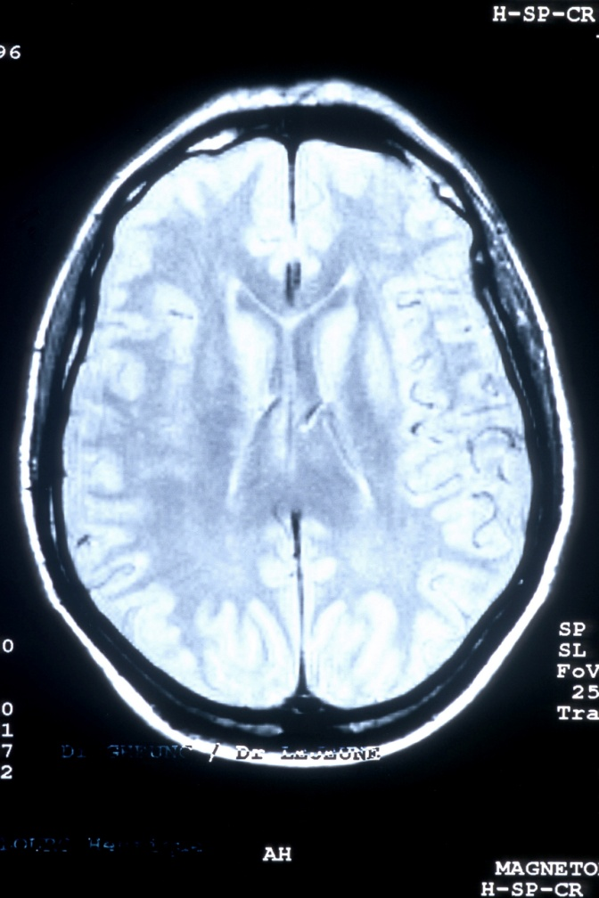
Impact of SUDs on Children
Addicted moms: pre/post-natal effects
Substance use disorders
Depression, anxiety
Oppositional behaviors
Medical problems
Academic problems
Impulsivity, inattention, irritability
Impairments of executive functions of brain (organize, plan, reason, problem-solve)
Cooke et al; Moss et al; Tartar et al; Suchman et al; Wilens & Biederman
Notes:
Speaker: Dennis
JH – Discussion point: transgenerational addiction patterns

Slide 14
Children with a SUD Member
These conditions of children of members with a SUD are significantly higher:
Trauma, otitis media, asthma
Pneumonia, Attention deficit disorder
Headache, depression
Acid related disorders
Substance use disorders
-C.Wiesner, 2010

Slide 15
Academic
“My dad’s addiction messed with me in lots of ways. Got in trouble with the law. I almost dropped out of school.”
Kids from drug abuse families had lower IQ scores and school performance compared to community controls
(Moss et. al., 1995; Tarter et. al., 1995)
Notes:
Speaker: Dennis

Slide 16
Emotional Distress: Anxiety & Depression
54% of kids admitted to a psychiatric hospital had parents with history of a SUD
53% of kids ages 8-12 living with drug abusing father had psychiatric disorder
In the words of children:
“It made me sad and afraid.”
“I worried that something bad would happen to dad.”
“I felt so alone and depressed.”
Salo & Flykt; Daley & Miller
Notes:
Speaker: Dennis

Slide 17
Abuse and Neglect
Substance abuse is involved in >70% of abuse and neglect cases (SAMHSA)
“Dad was never around. I felt lonely for him. I also felt sorry he couldn’t be with us.”
Notes:
Speaker: Dennis

Slide 18
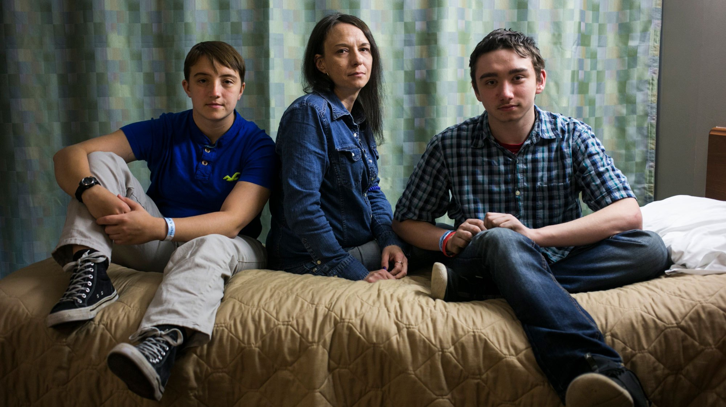
Children of the Opioid Epidemic Are Flooding Foster Homes. America Is Turning a Blind Eye
1/3 of children placed in out of home care due to parental SUDs
Are placed with relatives, an increase of 40%+ in 2014 (SAMHSA)

Slide 19
Each person who dies from an overdose, accident, disease or other cause. . .
Leaves behind family members and others
“I light this candle for my dad who died when I was 3 years old.”
“My sister left behind 4 children when she OD’ed on fentanyl.”
“I lost 2 brothers and a cousin to drugs.”
“Another form of grief: grieving someone alive”

Slide 20
Objective #3
Barriers and
Challenges Facing Individuals with SUDs, Families, and Providers
Notes:
Speaker: John

Slide 21
Client Barriers to Involving Family
Shame, guilt over past behaviors
Belief “it’s MY problem”
Other commitments (e.g., childcare)
There’s something they don’t want you to know
Hate being told what to do
Clinicians need to work with clients to overcome barriers
Notes:
Speaker: John

Slide 22
Many EBPs Address Family Issues in Individual, Group or Family Sessions
EBPs for SUDs
Individual Therapies (CBT, IDC, IPT)
Group Therapies (GDC)
MATRIX Model (Family Module)
Relapse Prevention
Marital & Family Therapies
Notes:
Speaker: John

Slide 23
Family Member with a SUD
Understand impact of SUD on your family and members, including kids
Encourage your family to become educated
Involve your family in treatment sessions
Encourage/facilitate Nar-Anon attendance
Make amends (Steps 8 & 9)
Help family member with SUD or psychiatric disorder get help
Notes:
Speaker: John

Slide 24
Family Barriers
Believe “it’s our fault”
Guilt and shame
Frustration with past recovery attempts
Unable to see how they can help member
Clients advise them not to go to sessions
Notes:
Speaker: John

Slide 25
Staff Barriers
I’m not qualified
Difficult to manage everyone
Families will “cause too much stress” and affect relapse
Frustration over inability to get members to sessions
Family lives in a different state or is not available
Notes:
Speaker: John

Slide 26
Family Interventions for Psychiatric and Substance Use Disorders (n=70+)
Many studies show increased engagement and retention rates for affected individuals, reduced family burden, and improvement among individuals with SUDs
and their family members
Notes:
Speaker: John

Slide 27
Worries Concerns Needs
Services
Programs & Gaps
Family Unit or
Members
Impact of SUD on Family
Family Recovery
Helping member with SUD
Self-Care

Slide 28
Objective #4
Interventions and Strategies to Help Families and Members Including
Children
Notes:
Speaker: John

Slide 29
What is Family Therapy?
A collection of approaches that share a belief in effectiveness of family involvement
A change in any part of the system may lead to change in other parts of the system
Family therapy has two main purposes:
Use family's strengths and resources to find ways to live without substances
Ameliorate the impact of SUDs on identified patient and family
Notes:
Speaker: John

Slide 30
Models of Family Therapy in Treatment of SUDs
Family disease
Family systems
CBT models
Multidimensional FT
Functional FT
Multi-Systemic FT
Brief, Strategic FT
Notes:
Speaker: John

Slide 31
Goals of Family Therapy
Help family become aware of own needs
Provide genuine, enduring healing for members
Shift power to parental figures
Improve communication in the family
Help family make changes to affect SUD member
Help keep SUD from moving to next generation
Help family solve problems
Notes:
Speaker: John

Slide 32
CRAFT Model Goals (for SUDs)
Get member with substance use disorder into treatment (64-86% success rate)
Get member to stop or reduce substance use
Adding incentives adds to improvement
Help families improve or enrich their own lives
Notes:
Speaker: Dennis

Slide 33
Outcomes of Family Engagement Interventions (SUDs)
Better engagement rates in treatment of SUD member with three EBPs:
ARISE 64%
BSFT 93%;
CRAFT 74%
Notes:
Speaker: Dennis

Slide 34
Family Studies (SUDs) (Liddle et al; NIDA; Williams et al; Szapocznik et al)
For adolescents, superior results of family therapy to other approaches:
Lower drug and alcohol use of adolescents
Improved school grades, pro-social behaviors
Improved family functioning
Sources: Myers et. al.; Liddle et. al.; Williams et al; Stanton & Standish; Santiban et al
Notes:
Speaker: Dennis

Slide 35
Outcomes of Family Interventions with Family & Members without a SUD
Improved family functioning: less conflict, improved structure, and communication, etc.
Reduced emotional burden: less anger, depression, anxiety
Reduced welfare dependence
Sources: CSAT; Liddle et al; Santiban et al; Szapocznik et al
Notes:
Speaker: Dennis

Slide 36
Behavioral Marital Therapy (BMT): Research Outcomes
Lower rates of substance use
Shorter, less severe relapses
Less domestic violence
Reduced HIV risk behaviors
Improvement in children
Cost savings $5-6.5K per
Improved marital relationship
Sources: O’Farrell et al.; Maisto et al; Klosterman & O’Farrell
Notes:
Speaker: Dennis

Slide 37
Strategies to Help the Family
Work with patient on impact of SUD on family
Encourage patient to get family to Al-Anon, Nar-Anon, other family support program
Provide family education, support, referral
Meet with individual family members
Provide/facilitate family education groups
Provide family “programs” (e.g., MATRIX model)
Provide/facilitate marital or family therapy
Notes:
Speaker: Dennis

Slide 38
Family Member without a SUD
Understand and accept the SUD, support recovery of addicted member, adjust to sobriety, deal with lapses and relapses
Establish family safety, get involved in tx and/or recovery, reduce emotional burden, help other members get help if needed
Focus on self care, detach, reduce enabling
Notes:
Speaker: Dennis

Slide 39
Strategies for Clinicians
Create family philosophy of care
Understand their experiences
Help family engage SUD member
Outreach to family
Invite to sessions
Call them (ask client, get written permission)
Notes:
Speaker: John

Slide 40
Strategies for Clinicians
Join with family; let them know you “need” their help with patient
Therapist is “part” of the team (respect if family says ‘no’)
Outreach if need to connect with family
Do not label family as resistant or co-dependent!
Be patient, flexible, accessible
Notes:
Speaker: John

Slide 41
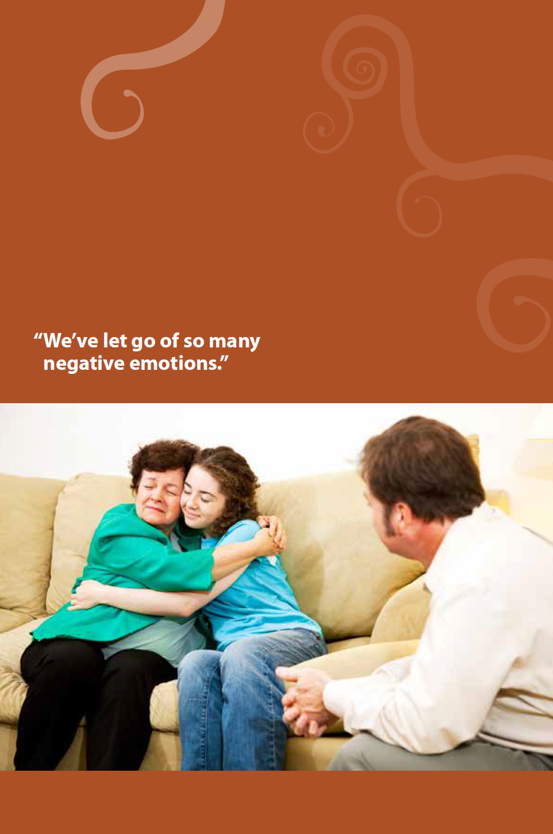
Reduce emotional chaos and burden of families
and members
Anxiety, worry, fear
Anger, resentment
Guilt, shame, embarrassment
Depression, grief
Notes:
Speaker: John

Slide 42
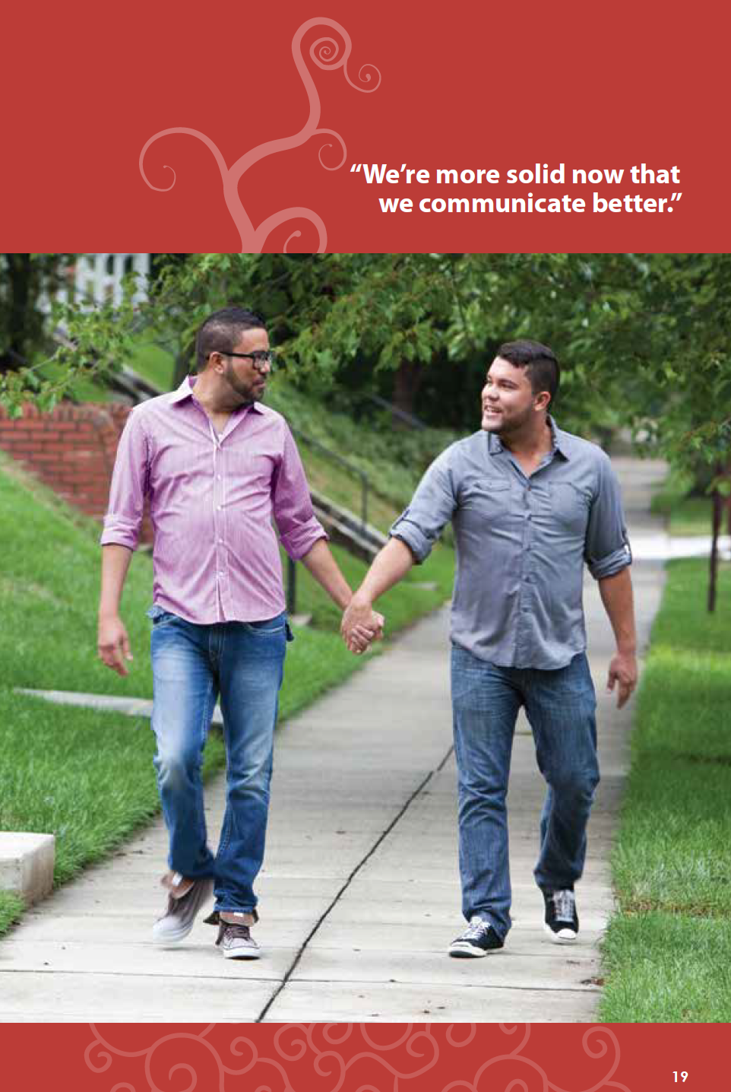
Improve Communication and Problem Solving
Reduce negative interactions and communication
Increase positive interactions, communication and support
Solve current problems
Increase family rituals and positive interactions
Notes:
Speaker: John

Slide 43
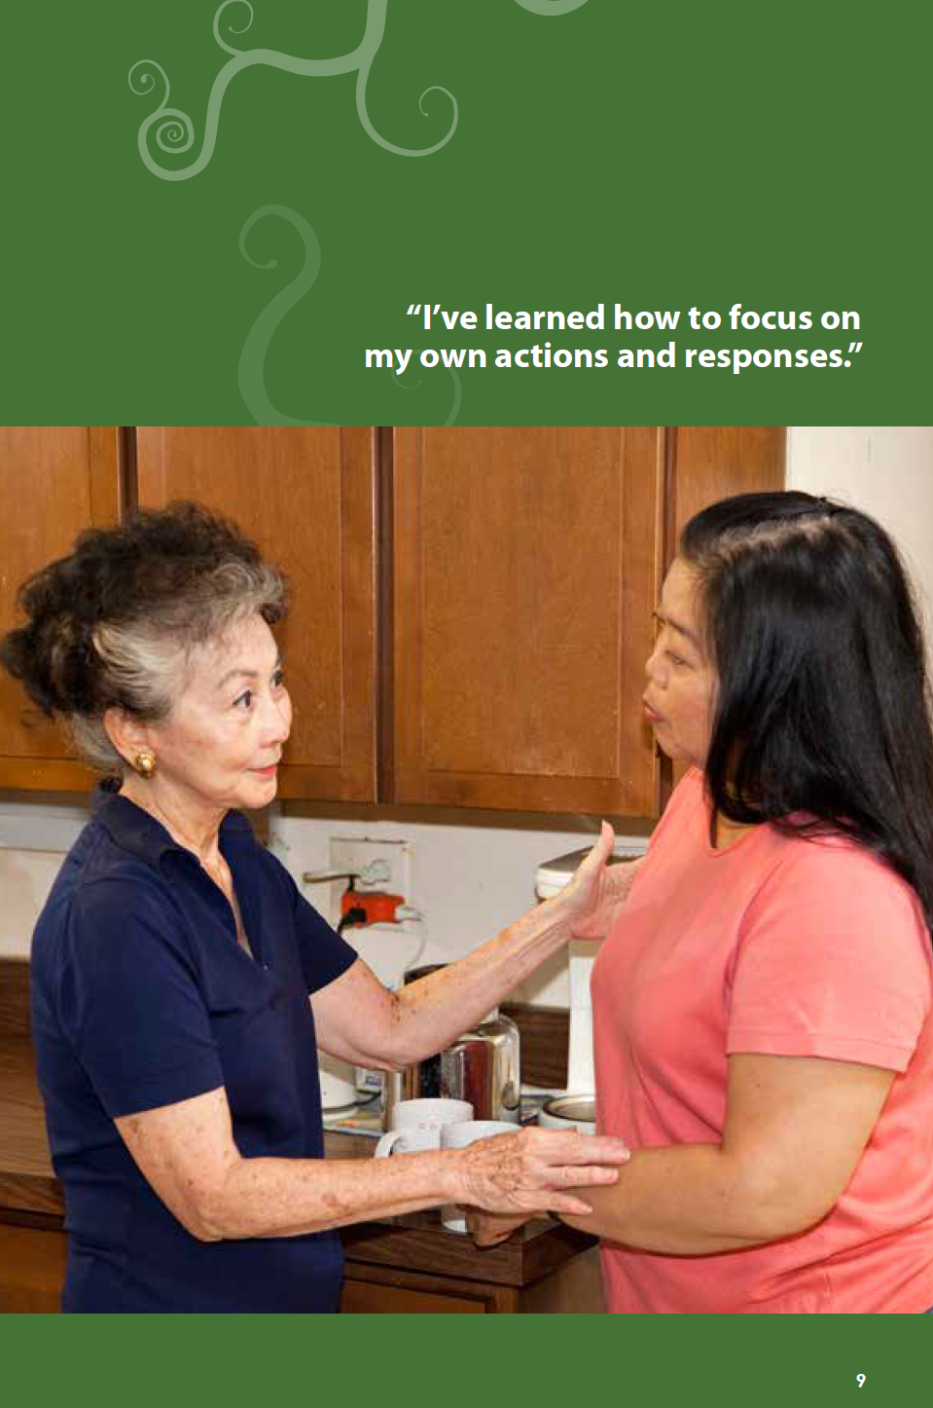
Focus on self for family member or significant other
Focus on own needs, desires, and issues
Hard to do at first as person is focused on ill family member
Manage negative reactions
Deal with emotional burden
Importance of social support
Preparation for the challenges of recovery (patient & family)
Notes:
Speaker: John

Slide 44
Parents Helping Their Children
Accept that children may have suffered negative effects from a parent’s SUD
Encourage children to talk about experiences, concerns, feelings
Protect children from violence, intoxicating behaviors, and other high risk behaviors
Do things together (share activities and positive family rituals)
Notes:
Speaker: Dennis

Slide 45
Parents Helping Their Children
Keep things normal at home (i.e., with family rituals)
Show interest in child’s outside activities and relationships
Have child attend some sessions with parent(s)
Get child help for any serious problem (psychiatric, behavioral, substance abuse)
Notes:
Speaker: Dennis

Slide 46
Thank you for your participation
Notes:
Speaker: Tracee

