Slide 1
Prescribing Buprenorphine in Primary Care
Julie Kmiec, DO
Assistant Professor of Psychiatry
University of Pittsburgh
kmiecj@upmc.edu
April 10, 2018

Slide 2
Objectives
Review prevalence of opioid use disorders
Discuss the unmet needs for those with OUD
Provide information on buprenorphine for opioid use disorder
Discuss barriers to providing buprenorphine treatment
Review model programs that have been implemented to improve access to treatment
Review overdose risk factors and naloxone

Slide 3
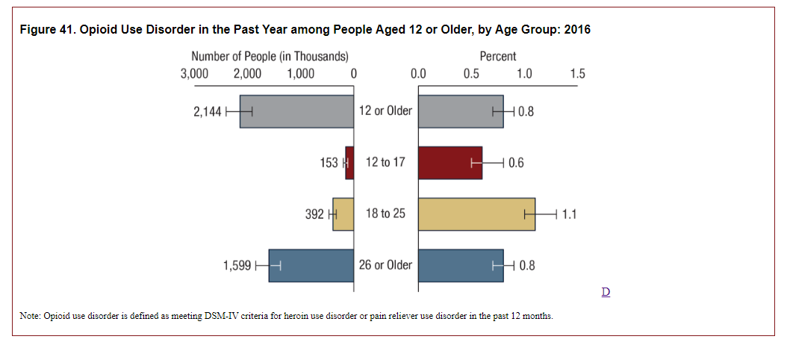
Substance Abuse and Mental Health Services Administration. (2017). Key substance use and mental health indicators in the United States: Results from the 2016 National Survey on Drug Use and Health (HHS Publication No. SMA 17-5044, NSDUH Series H-52). Rockville, MD: Center for Behavioral Health Statistics and Quality, Substance Abuse and Mental Health Services Administration. Retrieved from https://www.samhsa.gov/data/

Slide 4
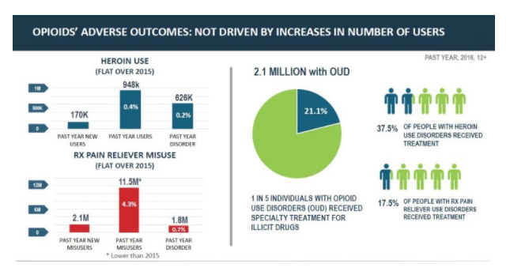
Specialty treatment
Hospital (IP only)
D&A rehab (IP or OP)
Mental health center
Nonspecialty treatment
ED
Private doctor’s office
Prison/jail
Self-help groups
NSDUH 2016

Slide 5
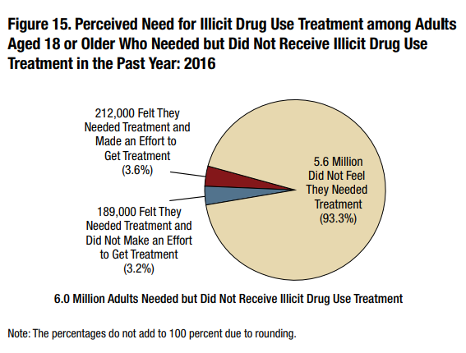
Park-Lee, E., Lipari, R. N., Hedden, S. L., Kroutil, L. A., & Porter, J. D. (2017, September). Receipt of services for substance use and mental health issues among adults: Results from the 2016 National Survey on Drug Use and Health. NSDUH Data Review. Retrieved from https://www.samhsa.gov/data

Slide 6
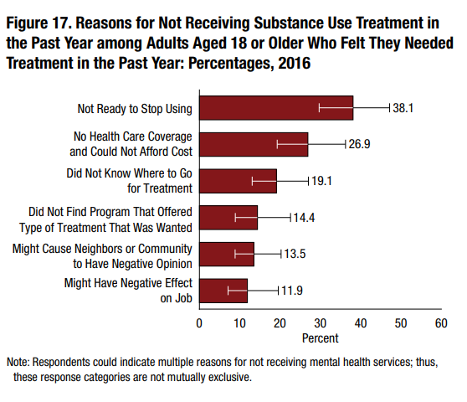
Park-Lee, E., Lipari, R. N., Hedden, S. L., Kroutil, L. A., & Porter, J. D. (2017, September). Receipt of services for substance use and mental health issues among adults: Results from the 2016 National Survey on Drug Use and Health. NSDUH Data Review. Retrieved from https://www.samhsa.gov/data

Slide 7
Some complications of opioid use disorder
Overdose
Increased mortality (6-20x higher than general population; Hser et al., 2015)
Infections
Cellulitis/abscess
Osteomyelitis
Septic emboli
Endophthalmitis
Endocarditis
HIV
HCV
32% become positive for HCV within 1 year of IDU
53% positive within 5 years (Hagan et al., 2008)
Notes:
Recall Scott County, IN, where HIV was diagnosed in 181 patients from Nov 2014-Nov 2015 and this was linked to IDU of oxymorphone and a majority of these people were co-infected with hepatitis C. Public health emergency was declared and they were able to set up syringe exchange.

Slide 8
Pharmacotherapy for OUD
One of many tools in the “recovery toolbox” we can offer to patients
Reduce cravings which can help stabilize and strengthen coping capacity
Allow patients to focus on behavioral therapies
Increase periods of abstinence and instill a sense of self-efficacy to help sustain recovery
Improve clinical outcomes for patients and reduce impact on families/loved ones

Slide 9
Pharmacotherapy for OUD
Evidence based treatments to
Decrease opioid and injection drug use
Reduce transmission of hepatitis C and HIV
Decrease criminal behavior
Retain people in treatment
Decrease overdose
Reduce sexual risk behaviors (e.g., trading sex for money/drugs)
Improve in physical and mental health and social functioning
References 3-17

Slide 10
Kakko et al., 2003
Controls – 6 day bup taper, daily dosing of placebo + relapse prevention
Buprenorphine – 16 mg bup + relapse prevention

Slide 11
Buprenorphine Prescribers in the U.S.

Slide 12
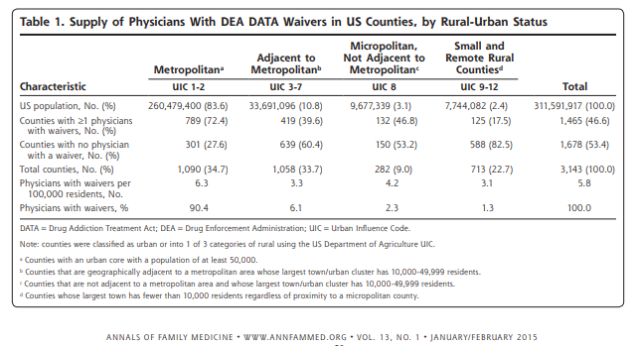
Rosenblatt RA, Andrilla CHA, Catlin M, Larson EH. Geographic and Specialty Distribution of US Physicians Trained to Treat Opioid Use Disorder. Annals of Family Medicine. 2015;13(1):23-26. doi:10.1370/afm.1735.

Slide 13
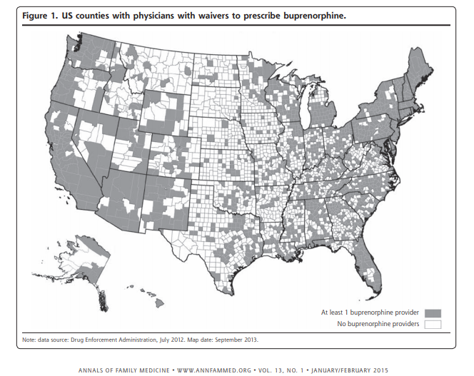
Rosenblatt RA, Andrilla CHA, Catlin M, Larson EH. Geographic and Specialty Distribution of US Physicians Trained to Treat Opioid Use Disorder. Annals of Family Medicine. 2015;13(1):23-26. doi:10.1370/afm.1735.

Slide 14
Change in Patient Limit for Buprenorphine
The Department of Health and Human Services published final rule which was effective 8/8/16 which increased the highest patient limit for qualified physicians to treat opioid use disorder to 275
Medication Assisted Treatment for Opioid Use Disorders: A Rule by the Health and Human Services Department on 07/08/2016 https://www.federalregister.gov/d/2016-16120. Accessed Sept 2, 2017.

Slide 15
Change in Patient Limit for Buprenorphine
Licensed physicians who have had a waiver to treat 100 patients for at least 1 year can become eligible for the patient limit of 275 in one of two ways:
By holding additional credentialing
Board certification in addiction medicine or addiction psychiatry
By practicing in a “qualified practice setting”
Understanding the Final Rule for a Patient Limit of 275. https://www.samhsa.gov/sites/default/files/programs_campaigns/medication_assisted/understanding-patient-limit275.pdf. Accessed Sept 2, 2017.

Slide 16
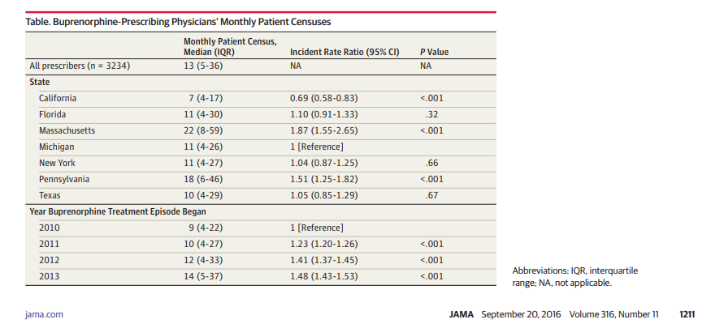
Physician Capacity to Treat OUD With Buprenorphine
Median episode duration = 53 days (IQR 20-120)
Stein BD, Sorbero M, Dick AW, Pacula RL, Burns RM, Gordon AJ. Physician Capacity to Treat Opioid Use Disorder With Buprenorphine-Assisted Treatment. JAMA. 2016
Sep 20;316(11):1211-1212. PubMed PMID: 27654608.

Slide 17
Physician Monthly Census for Buprenorphine
Stein BD, Sorbero M, Dick AW, Pacula RL, Burns RM, Gordon AJ. Physician Capacity to Treat Opioid Use Disorder With Buprenorphine-Assisted Treatment. JAMA. 2016
Sep 20;316(11):1211-1212. PubMed PMID: 27654608.

Slide 18
CARA Allows Additional Prescribers
Qualifying APRNs and PA-Cs given ability to prescribe buprenorphine for OUD until 10/1/21
Have to complete 24 hours of training to be eligible for a waiver
8 of the hours can be the course that physicians have traditionally taken
Follow the 30 and 100 patient limits
Works with, or is supervised by, a qualifying physician if required by state law
Public Law 114-198. https://www.congress.gov/114/plaws/publ198/PLAW-114publ198.pdf. Accessed Sept 2, 2017.

Slide 19
Additional Prescribers
30 patient waivers as of 8/29/17:
Nurse practitioners: 2,471
Physician assistants: 687

Slide 20
Ambulatory Visits
In 2015,
990.8 million ambulatory care visits in the US
51.2% of these visits were to primary care
Primary care providers see the largest percentage of outpatients
Primary care providers have an opportunity to provide treatment and have an impact on the opioid epidemic
Rui P, Okeyode T. National Ambulatory Medical Care Survey: 2015 State and National Summary Tables. Available from: http://www.cdc.gov/nchs/ahcd/ahcd_ products.htm.

Slide 21
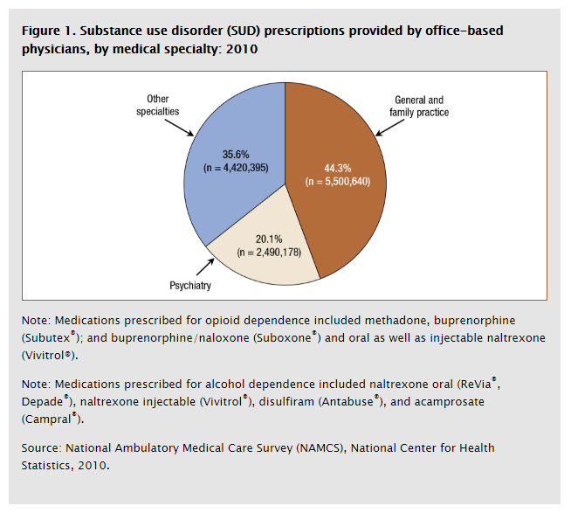
Primary Care Providing SUD Tx
Patient’s PCP wrote 32.5% of the prescriptions for SUD. 34.3% included some sort of behavioral treatment, 27.1% including both psychotherapy and other mental health counseling.
Margaret E. Mattson, Ph.D. and Sean Lynch, Ph.D., L.C.S.W. The CBHSQ Report: Medication Prescribing and Behavioral Treatment for Substance Use Disorders in Physician Office Settings. Substance Abuse and Mental Health Services Administration, Center for Behavioral Health Statistics and Quality. Rockville, MD.

Slide 22
FDA-approved Medications for Opioid Use Disorder
Full agonist
Methadone
Partial agonist
Buprenorphine/naloxone
Buprenorphine
Antagonist
Naltrexone
Naltrexone-XR

Slide 23
Buprenorphine
In 2000, DATA was passed which allowed physicians to treat patients with opioid use disorder with schedule III-V drugs which were specifically approved by the FDA for opioid use disorder
In 2002, FDA approved buprenorphine and buprenorphine/naloxone for treatment of opioid use disorder

Slide 24
Buprenorphine/Naloxone
Buprenorphine – partial mu-opioid agonist which partially binds to the opioid receptor
Has very high affinity for mu receptor
Has slow dissociation from mu receptor
Because it is a partial mu agonist it has a ceiling effect, which means larger doses do not result in larger effects, so safer in overdose (with some exceptions)
Naloxone – opioid antagonist which is not active if the medication is taken as directed
Naloxone 2-10% bioavailable

Slide 25
Mu-Opioid Effects

Slide 26
Formulations
Formulations of buprenorphine for treatment of OUD
 | SL tab | SL film | Buccal film | Implant | Long-acting injectable
buprenorphine (generic) | x
bup/nx (generic) | x
Suboxone |  | x | x
Zubsolv | x
Bunavail |  |  | x
Probuphine |  |  |  | x
Sublocade |  |  |  |  | x

Slide 27
Dose equivalents of sublingual and buccal formulations
 | Equivalent Buprenorphine Dose (Naloxone Dose Noted if Included in Formulation)
 | 1 mg | 2 mg | 4 mg | 8 mg | 12 mg | 16 mg
buprenorphine (generic) |  | 2 |  | 8
bup/nx (generic) |  | 2/0.5 |  | 8/2
Suboxone (bup/nx) |  | 2/0.5 | 4/1 | 8/2 | 12/3
Zubsolv (bup/nx) | 0.7/0.18 | 1.4/0.36 | 2.9/0.71 | 5.7/1.4 | 8.6/2.1 | 11.4/2.9
Bunavail (bup/nx) |  |  | 2.1/0.3 | 4.2/0.7 | 6.3/1

Slide 28
Buprenorphine Induction
To start on buprenorphine, patients need to be in visible opioid withdrawal otherwise risk precipitated withdrawal
Induction is typically 4-8 mg of buprenorphine
Induction and stabilization is usually accomplished in a matter of 7 days

Slide 29
Buprenorphine
Patients usually come to office weekly at first
Get 1-week supply of medication
Give urine specimen each visit
Need to do some form of psychosocial treatment
When stable, advance treatment, giving 2-week supply of medication
If there is a lapse, then resume weekly visits

Slide 30
Implantable buprenorphine (Probuphine)
4 rods implanted in arm, 74.2 mg each (equivalent to 80 mg of buprenorphine HCl)
Patients stable on 8 mg of buprenorphine or less
Implanted and removed by someone who can perform minor surgical procedures
Removed after 6 months, new rods can be implanted in the other arm

Slide 31
Long-acting injectable buprenorphine (Sublocade)
7 days with transmucosal buprenorphine (8-24 mg)
300 mg SC x2 months
100 mg SC monthly thereafter for maintenance
May increase to 300 mg monthly if suboptimal response to 100 mg (+UDS, self-reported use)
Minimum time between doses = 26 days
Steady state in 4-6 months
If missed dose, give as soon as possible
Noted that occasional delays up to 2 weeks may not have clinically significant impact
After steady state is achieved, patients stopping injections may have buprenorphine detectable in plasma for up to 12 months
Correlation between plasma and urine concentrations not studied

Slide 32
Barriers to PCPs Prescribing Buprenorphine
Provided wavier training to 120 physicians in WA
Surveyed 7 months after course
92 responded
78 responses included
50 (64.1%) obtained their waiver
22 (28.2%) started prescribing buprenorphine
21 (95%) were family medicine
1 psychiatrist
9 placed their name on SAMHSA treatment locator
Hutchinson E, Catlin M, Andrilla CH, Baldwin LM, Rosenblatt RA. Barriers to primary care physicians prescribing buprenorphine. Ann Fam Med. 2014
Mar-Apr;12(2):128-33. PubMed PMID: 24615308

Slide 33
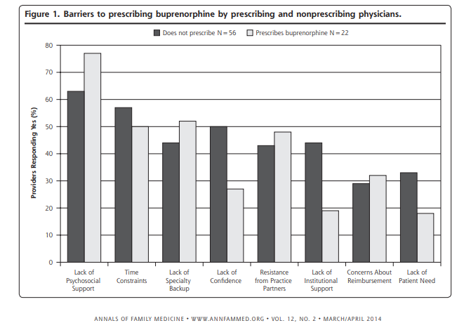
Barriers to Prescribing Buprenorphine
Hutchinson E, Catlin M, Andrilla CH, Baldwin LM, Rosenblatt RA. Barriers to primary care physicians prescribing buprenorphine. Ann Fam Med. 2014
Mar-Apr;12(2):128-33. PubMed PMID: 24615308

Slide 34
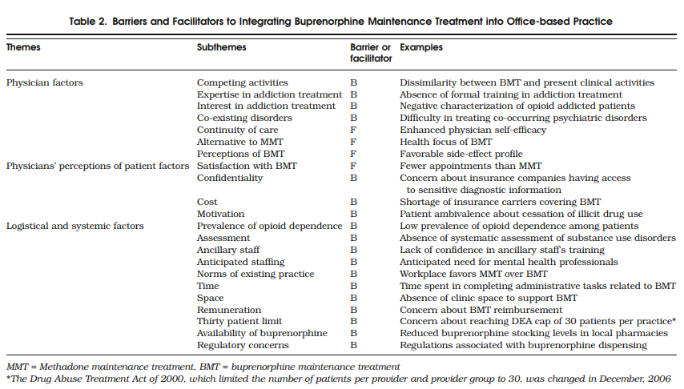
Facilitators and Barriers of Implementing Buprenorphine
Barry DT, Irwin KS, Jones ES, Becker WC, Tetrault JM, Sullivan LE, Hansen H, O'Connor PG, Schottenfeld RS, Fiellin DA. Integrating buprenorphine treatment
into office-based practice: a qualitative study. J Gen Intern Med. 2009 Feb;24(2):218-25. PubMed PMID: 19089500

Slide 35
Massachusetts: Nurse Care Manager (NCM) Model
Alford DP, LaBelle CT, Kretsch N, Bergeron A, Winter M, Botticelli M, Samet JH. Collaborative care of opioid-addicted patients in primary care using buprenorphine: five-year experience. Arch Intern Med. 2011 Mar 14;171(5):425-31. PubMed PMID: 21403039

Slide 36
Nurse Care Manager Model
Program coordinator (previous medical assistant) trained to collect standardized intake info
Nurse program director reviewed the intake and triaged the patient to
NCM and physician intake appointments
other treatment options
NCM (RNs) completed 1 day buprenorphine training
Alford DP, LaBelle CT, Kretsch N, Bergeron A, Winter M, Botticelli M, Samet JH. Collaborative care of opioid-addicted patients in primary care using buprenorphine: five-year experience. Arch Intern Med. 2011 Mar 14;171(5):425-31. PubMed PMID: 21403039

Slide 37
Nurse Care Manager Model
NCMs followed treatment protocols and performed patient care roles
Assess for appropriateness for OBOT
Educate patients
Obtain informed consent
Develop treatment plans
Oversee medication management
Refer to other addiction treatment
Monitor for treatment adherence
Communicate with prescribing physicians, addiction counselors, and pharmacists
pharmacist collaboration allowed buprenorphine prescriptions with multiple refills and cancelation of the refills if the patient was non-adherent
Alford DP, LaBelle CT, Kretsch N, Bergeron A, Winter M, Botticelli M, Samet JH. Collaborative care of opioid-addicted patients in primary care using buprenorphine: five-year experience. Arch Intern Med. 2011 Mar 14;171(5):425-31. PubMed PMID: 21403039

Slide 38
Nurse Care Manager Model
Physicians
Reviewed and supplemented the NCM assessments
Reviewed lab results
Performed physical exams
Prescribed buprenorphine
Followed patients at least every 6 months, more frequently if needed
Co-management with psychiatrist if needed
Alford DP, LaBelle CT, Kretsch N, Bergeron A, Winter M, Botticelli M, Samet JH. Collaborative care of opioid-addicted patients in primary care using buprenorphine: five-year experience. Arch Intern Med. 2011 Mar 14;171(5):425-31. PubMed PMID: 21403039

Slide 39
Nurse Care Manager Model
3 stages of treatment
NCM and physician assessment (appropriateness for OBOT and intake evaluations)
NCM supervised induction and stabilization
Maintenance (buprenorphine treatment with monitoring for illicit drug use and weekly counseling) or discharge
Alford DP, LaBelle CT, Kretsch N, Bergeron A, Winter M, Botticelli M, Samet JH. Collaborative care of opioid-addicted patients in primary care using buprenorphine: five-year experience. Arch Intern Med. 2011 Mar 14;171(5):425-31. PubMed PMID: 21403039

Slide 40
Nurse Care Manager Model
Physician prescribed buprenorphine, following induction protocol
Office induction, NCM observed for signs of opioid withdrawal
prior to the first dose of buprenorphine
precipitated withdrawal after the first dose
Physicians not present during induction but available by pager
Alford DP, LaBelle CT, Kretsch N, Bergeron A, Winter M, Botticelli M, Samet JH. Collaborative care of opioid-addicted patients in primary care using buprenorphine: five-year experience. Arch Intern Med. 2011 Mar 14;171(5):425-31. PubMed PMID: 21403039

Slide 41
Nurse Care Manager Model
During stabilization (days 2–7), patients took dose at home
At least daily phone contact with the NCM to assess for withdrawal and adverse effects
Dose adjustments were made based on program protocols
All patients had a follow-up NCM visit on day 8 or sooner
Alford DP, LaBelle CT, Kretsch N, Bergeron A, Winter M, Botticelli M, Samet JH. Collaborative care of opioid-addicted patients in primary care using buprenorphine: five-year experience. Arch Intern Med. 2011 Mar 14;171(5):425-31. PubMed PMID: 21403039

Slide 42
Nurse Care Manager Model
Maintenance
Weekly follow-up with NCM for 4–6 weeks, then every 2 weeks if adherent to treatment , decreasing frequency with stability
Urine drug tests at every NCM visit and physician visit; typically unsupervised
If seen less than monthly, had up to 6 random “call-backs” per year
Patients with unexpected urine drug tests were called to meet with the NCM
Nonadherence resulted in NCM intensifying treatment
Patients encouraged to attend self help groups and mandatory weekly addiction counseling
Alford DP, LaBelle CT, Kretsch N, Bergeron A, Winter M, Botticelli M, Samet JH. Collaborative care of opioid-addicted patients in primary care using buprenorphine: five-year experience. Arch Intern Med. 2011 Mar 14;171(5):425-31. PubMed PMID: 21403039
Notes:
All patients were subject to call-backs for urine drug tests, observed dosing, pill counts, or treatment plan revisions
Intensified treatment included: 2 or more visits per week for pill counts, observed urine drug tests, adjusted buprenorphine dose, intensified counseling

Slide 43
Nurse Care Manager Model
Discharge
Referred to methadone maintenance treatment if they continued to use illicit opiates or needed more structured care
Involuntarily discharged if declined transfer to MMT
Involuntarily discharged if disruptive behavior
Could request taper at any time, encouraged to wait for at least 6 months of recovery
Alford DP, LaBelle CT, Kretsch N, Bergeron A, Winter M, Botticelli M, Samet JH. Collaborative care of opioid-addicted patients in primary care using buprenorphine: five-year experience. Arch Intern Med. 2011 Mar 14;171(5):425-31. PubMed PMID: 21403039

Slide 44
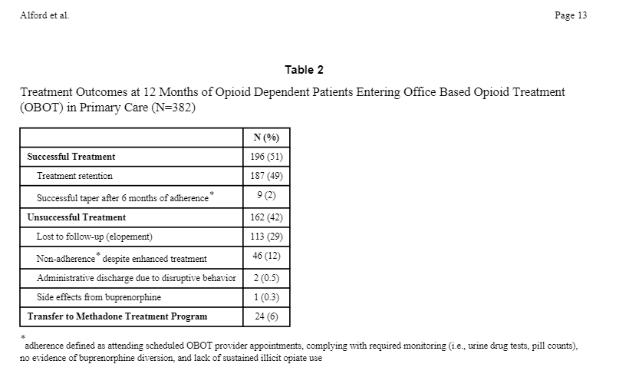
Nurse Care Manager Model
Alford DP, LaBelle CT, Kretsch N, Bergeron A, Winter M, Botticelli M, Samet JH. Collaborative care of opioid-addicted patients in primary care using buprenorphine: five-year experience. Arch Intern Med. 2011 Mar 14;171(5):425-31. PubMed PMID: 21403039

Slide 45
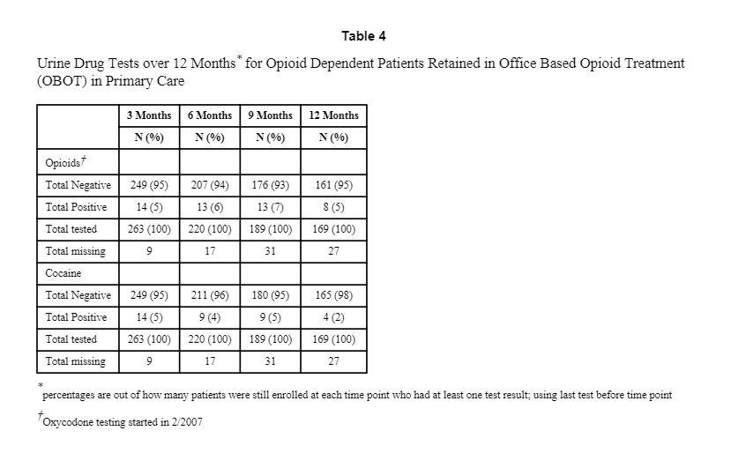
Nurse Care Manager Model
Alford DP, LaBelle CT, Kretsch N, Bergeron A, Winter M, Botticelli M, Samet JH. Collaborative care of opioid-addicted patients in primary care using buprenorphine: five-year experience. Arch Intern Med. 2011 Mar 14;171(5):425-31. PubMed PMID: 21403039

Slide 46
Vermont: Hub and Spoke Model

Slide 47
Vermont Hub & Spoke Model
Vermont was historically underserved, first OTP opened in 2002
Patients on wait-list
Somewhat alleviated with introduction of buprenorphine, but still unmet need due to physicians treating small numbers of patients due to concerns related to buprenorphine
OTP wait-list grew
Noted need for specialized clinic to
Perform buprenorphine induction and stabilization
Treat complicated patients
Treat unstable patients
Brooklyn JR, Sigmon SC. Vermont Hub-and-Spoke Model of Care for Opioid Use Disorder: Development, Implementation, and Impact. J Addict Med. 2017
Jul/Aug;11(4):286-292. PubMed PMID: 28379862

Slide 48
Vermont Hub & Spoke Model
Developed hub and spoke model
Hub in 5 regions of Vermont
Spokes are buprenorphine providers
Spokes can seek consultation from hub, regarding screening, induction, referrals
Idea that spokes will expand their capacity if they have extra support
Support for spoke includes MAT team: 1 full-time equivalent RN and 1 master’s level BH provider per 100 Medicaid patients
Brooklyn JR, Sigmon SC. Vermont Hub-and-Spoke Model of Care for Opioid Use Disorder: Development, Implementation, and Impact. J Addict Med. 2017
Jul/Aug;11(4):286-292. PubMed PMID: 28379862

Slide 49
Vermont Hub & Spoke Model
RN role:
Meets with new patients
Reviews contracts and consents
Arranges for insurance authorization
Arranges for urine drug testing
Authorizes buprenorphine refills to pharmacies
Monitors the PDMP
Oversees diversion control (random call-backs)
Brooklyn JR, Sigmon SC. Vermont Hub-and-Spoke Model of Care for Opioid Use Disorder: Development, Implementation, and Impact. J Addict Med. 2017
Jul/Aug;11(4):286-292. PubMed PMID: 28379862

Slide 50
Vermont Hub & Spoke Model
Behavioral health provider role:
Coordinates counseling
Crisis managment
Brief supportive counseling
Assists with practical issues
Coordinates referrals between the spoke and hub
Brooklyn JR, Sigmon SC. Vermont Hub-and-Spoke Model of Care for Opioid Use Disorder: Development, Implementation, and Impact. J Addict Med. 2017
Jul/Aug;11(4):286-292. PubMed PMID: 28379862

Slide 51
Vermont Hub & Spoke Model
From 2012 to 2016, there was a 64% increase in waivered physicians (173 to 283)
The number prescribed buprenorphine by individual physicians increased
More than 50% of spoke providers treated more than 10 patients
By September 2015,
23% had more than 30 patients
10% had more than 50 patients
Brooklyn JR, Sigmon SC. Vermont Hub-and-Spoke Model of Care for Opioid Use Disorder: Development, Implementation, and Impact. J Addict Med. 2017
Jul/Aug;11(4):286-292. PubMed PMID: 28379862

Slide 52
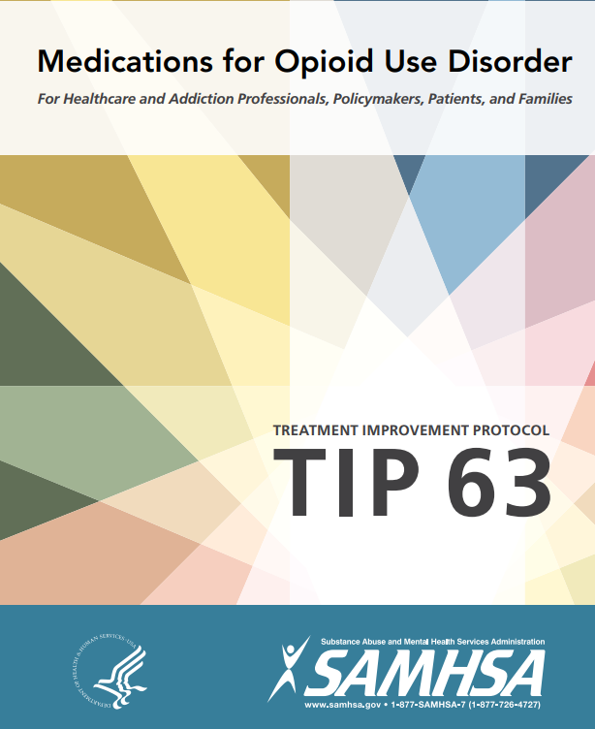

Slide 53
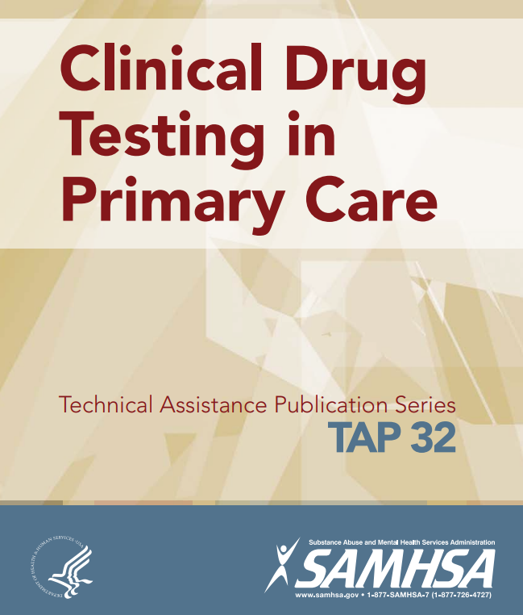

Slide 54
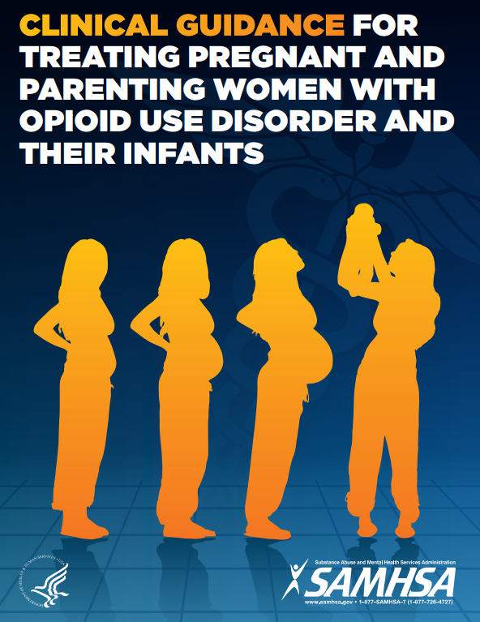

Slide 55
Additional Resources
PCSS-now.org
Webinars (upcoming and archived)
Buprenorphine waiver training (online or live)
Clinical coaching (one:one coaching, small group discussions)
Resources (e.g., clinical tools)
AAAP received SAMHSA grant to provide training and technical assistance on evidence-based practices to combat opioid crisis

Slide 56
Overdose & Naloxone

Slide 57
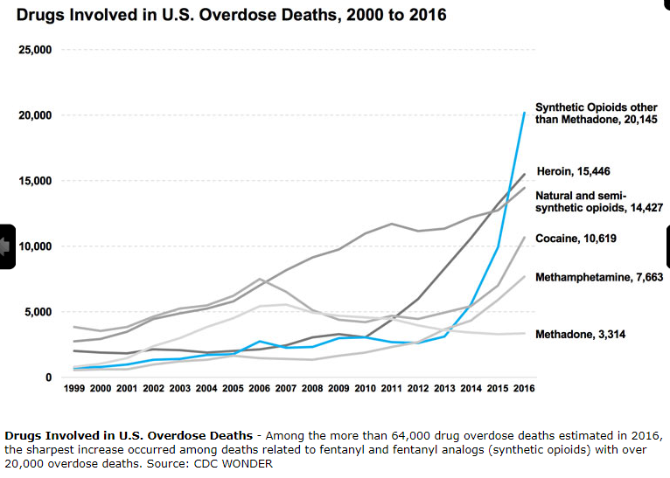
https://www.drugabuse.gov/related-topics/trends-statistics/overdose-death-rates; Accessed 10-21-17

Slide 58
Overdose Risk Factors
Using more than 100 mg of oral morphine equivalents daily (Bohnert et al. 2011)
Recent release from controlled environment
Incarceration (Binswanger et al., 2013)
Treatment (Strang et al. 2003; Saitz et al. 2007)
Mixing opioids with benzos, alcohol, other drugs (Powis et al., 1999)
Using alone
Medical conditions (renal, hepatic, pulmonary diseases, HIV)
Smoking

Slide 59
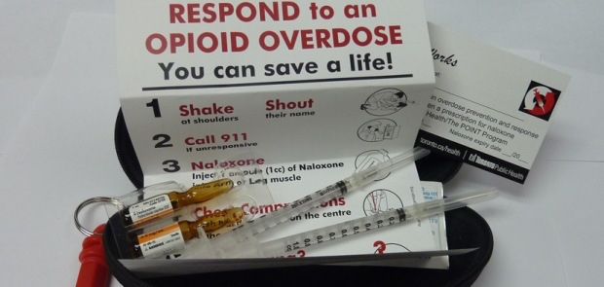
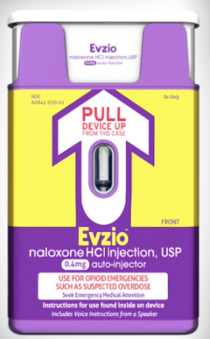
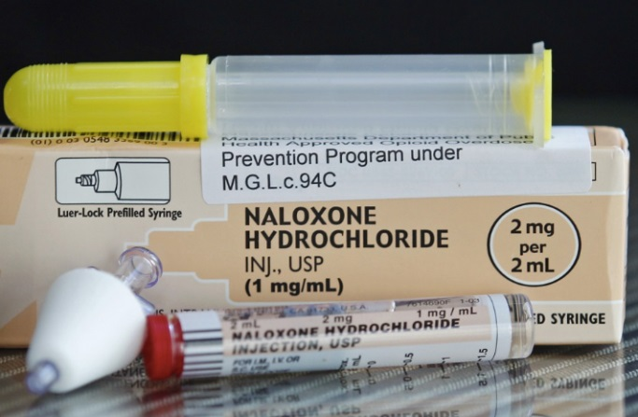
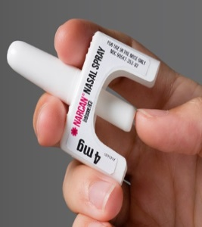
Naloxone for bystander administration
Intramuscular
Traditional
Auto-injector
Intranasal
With MAD (off-label)
NARCAN nasal spray
For more info, go to
prescribetoprevent.org

Slide 60
Questions/Discussion

Slide 61
References
Hagan H, Pouget ER, Des Jarlais DC, Lelutiu-Weinberger C. Meta-regression of hepatitis C virus infection in relation to time since onset of illicit drug injection: the influence of time and place. Am J Epidemiol 2008;168:1099-109.
Hser YI, Evans E, Grella C, Ling W, Anglin D. Long-term course of opioid addiction. Harv Rev Psychiatry. 2015 Mar-Apr;23(2):76-89. doi:10.1097/HRP.0000000000000052. Review. PubMed PMID: 25747921.
Marsch LA. The efficacy of methadone maintenance interventions in reducing illicit opiate use, HIV risk behavior and criminality: a meta-analysis. Addiction. 1998 Apr;93(4):515-32.
Committee on the Prevention of HIV Infection Among Injecting Drug Users in High-Risk Countries. Preventing HIV Infection Among Injecting Drug Users in High-Risk Countries: An Assessment of the Evidence. In: Tilson H, Aramrattana A, Bozzette S, editors. Washington, DC: Institute of Medicine of the National Academy of Sciences, 2007.
WHO. Guidelines for the psychosocially assisted pharmacological treatment of opioid dependence. Geneva: World Health Organization, 2009.
Gowing L, Farrell M, Bornemann R, Sullivan LE, Ali R. Substitution treatment of injecting opioid users for prevention of HIV infection (Review). The Cochrane Library: The Cochrane Collaboration, 2009.
WHO. Evidence for Action Technical Papers: Effectiveness of drug dependence treatment in preventing HIV among injecting drug users. In: World Health Organization, editor. Geneva, 2005.
Faggiano F, Vigna-Taglianti F, Versino E, Lemma P. Methadone maintenance at different dosages for opioid dependence. Cochrane Database Syst Rev 2009;3:CD002208.
Mattick RP, Breen C, Kimber J, Davoli M. Methadone maintenance therapy versus no opioid replacement therapy for opioid dependence. Cochrane Database Syst Rev 2009;1:CD002209.
Sullivan LE, Metzger DS, Fudala PJ, Fiellin DA. Decreasing international HIV transmission: the role of expanding access to opioid agonist therapies for injection drug users. Addiction 2005;100(2):150- 58.
Amato L, Davoli M, Perucci CA, Ferri M, Faggiano F, Mattick RP. An overview of systematic reviews of the effectiveness of opiate maintenance therapies: available evidence to inform clinical practice and research. J Subst Abuse Treat 2005;28:321-29.

Slide 62
References
Mattick RP, Breen C, Kimber J, Davoli M. Buprenorphine maintenance versus placebo or methadone maintenance for opioid dependence. Cochrane Database Syst Rev 2009;3:CD002207.
WHO, UNODC, UNAIDS. WHO/UNODC/UNAIDS position paper: Substitution maintenance therapy in the management of opioid dependence and HIV/AIDs prevention. Geneva: World Health Organisation, 2004.
Ward J, Mattick RP, Hall W, editors. Methadone Maintenance Treatment and Other Opioid Replacement Therapies. Amsterdam: Harwood Academic Publishers, 1998.
Wong K-h, Lee S-s, Lim W-l, Low H-k. Adherence to methadone is associated with a lower level of HIV related risk behaviors in drug users. J Subst Abuse Treat 2003;24(3):233-9.
Nolan S, Dias Lima V, Fairbairn N, Kerr T, Montaner J, Grebely J, Wood E. The impact of methadone maintenance therapy on hepatitis C incidence among illicit drug users. Addiction. 2014 Dec;109(12):2053-9. doi: 10.1111/add.12682. Epub 2014 Aug 14.
Kakko J, Svanborg KD, Kreek MJ, Heilig M. 1-year retention and social function after buprenorphine-assisted relapse prevention treatment for heroin dependence in Sweden: a randomised, placebo-controlled trial. Lancet. 2003 Feb 22;361(9358):662-8.
Harris DS, Jones RT, Welm S, Upton RA, Lin E, Mendelson J. Buprenorphine and naloxone co-administration in opiate-dependent patients stabilized on sublingual buprenorphine. Drug Alcohol Depend. 2000 Dec 22;61(1):85-94. PubMed PMID:11064186.
Greenwald MK, Johanson CE, Moody DE, Woods JH, Kilbourn MR, Koeppe RA, Schuster CR, Zubieta JK. Effects of buprenorphine maintenance dose on mu-opioid receptor availability, plasma concentrations, and antagonist blockade in heroin-dependent volunteers. Neuropsychopharmacology. 2003 Nov;28(11):2000-9. PubMed PMID: 12902992.
Clark RE, Baxter JD, Aweh G, O'Connell E, Fisher WH, Barton BA. Risk Factors or Relapse and Higher Costs Among Medicaid Members with Opioid Dependence or Abuse: Opioid Agonists, Comorbidities, and Treatment History. J Subst Abuse Treat. 2015 Oct;57:75-80. doi: 10.1016/j.jsat.2015.05.001. Epub 2015 May 7. PubMed PMID: 25997674; PubMed Central PMCID: PMC4560989.
Center for Substance Abuse Treatment. Medication-Assisted Treatment for Opioid Addiction in Opioid Treatment Programs. Rockville (MD): Substance Abuse and Mental Health Services Administration (US); 2005. PubMed PMID: 22514849.

